Slide 1
Attacks in Alexa Ecosystem
Presented by: Shivam Pandit

Slide 2
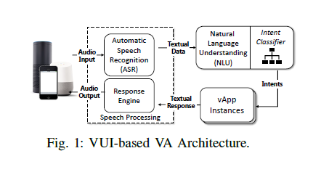
Typical VUI Architecture

Slide 3
Issues
Security Concerns in Voice Assistants Semantic Misinterpretations: VA’s are found to misclassify things based on speech understanding that can cause security concern Attacks on ASR & Intent Classifier: Attacks on Automatic Speech Recognition and intent classifier are big concern as attackers leverage common spoken errors to breach vApp integrity for malicious intent NLU’s Intent Classifier Intent Classifier may misinterpret something other than user intent based on machine understanding

Slide 4
Security Aspects
Voice assistants allow us to directly control computational devices like phones, tablets that emphasizes need of security.
User voice commands can be misinterpreted by NLU intent classifier to give undesired results.
ASR and intent classifier are both proven to misinterpret the spoken command by users that can be leveraged by hackers to intrude privacy.

Slide 5

Security Aspects

Slide 6


Attack consequences
Denial of service
Phishing
Privacy leakage
In-vApp purchasing

Slide 7
How do skills get
certified?

Slide 8

Developers makes the skill,
tests the functionalities and then submits it for certification.
Amazon reviews the skill and checks for certain submission requirements.
After certification, the skill is published and available to end users.

Slide 9
But what if you want to change the functionalities or update the content?

Slide 10

Amazon requires a skill to be recertified when the developer makes a change in the interaction model.
A change of code done in the backend do not require a re-certification.

Slide 11


Alexa skill
Interaction Model
Backend resources
In the form of a JSON file.
Can be written in Python, nodejs, java, php etc.
Alexa Skill Developer Console | AWS Lambda
Dialogue flow
Webhook

Slide 12
Content Changing
Attacks!

Slide 13
Affect the children by providing inappropriate content.
Can change Alexa replies to ask users for private data
Consequences

Slide 14
Attack scenario 1
Inappropriate Data to Children
What? The content being delivered on skills meant for children can be changed and content that is not suitable for children can be given.
Children’s skills
Developers have to mention the category in which a skill should belong in. If the developer specifies it as Kids skill, then parental permission is requested before enabling the app on the alexa device *
Why?
Amazon doesn’t monitor what happens in the backend resources after the skill is deployed.

Slide 15

Freetime
“ Amazon FreeTime on Alexa includes a new set of parental controls and family-focused features such as explicit song filtering, bedtime limits, educational Q&A, household communications, positive reinforcement for using the word “please,” disabled voice purchasing, and more. “

Slide 16
Freetime
Parents control skills.
Can stop children from using in-vApp purchasing.
But...
Once parent has enabled skill, they cant monitor.
Activity shows only the users command, not the alexa response.

Slide 17
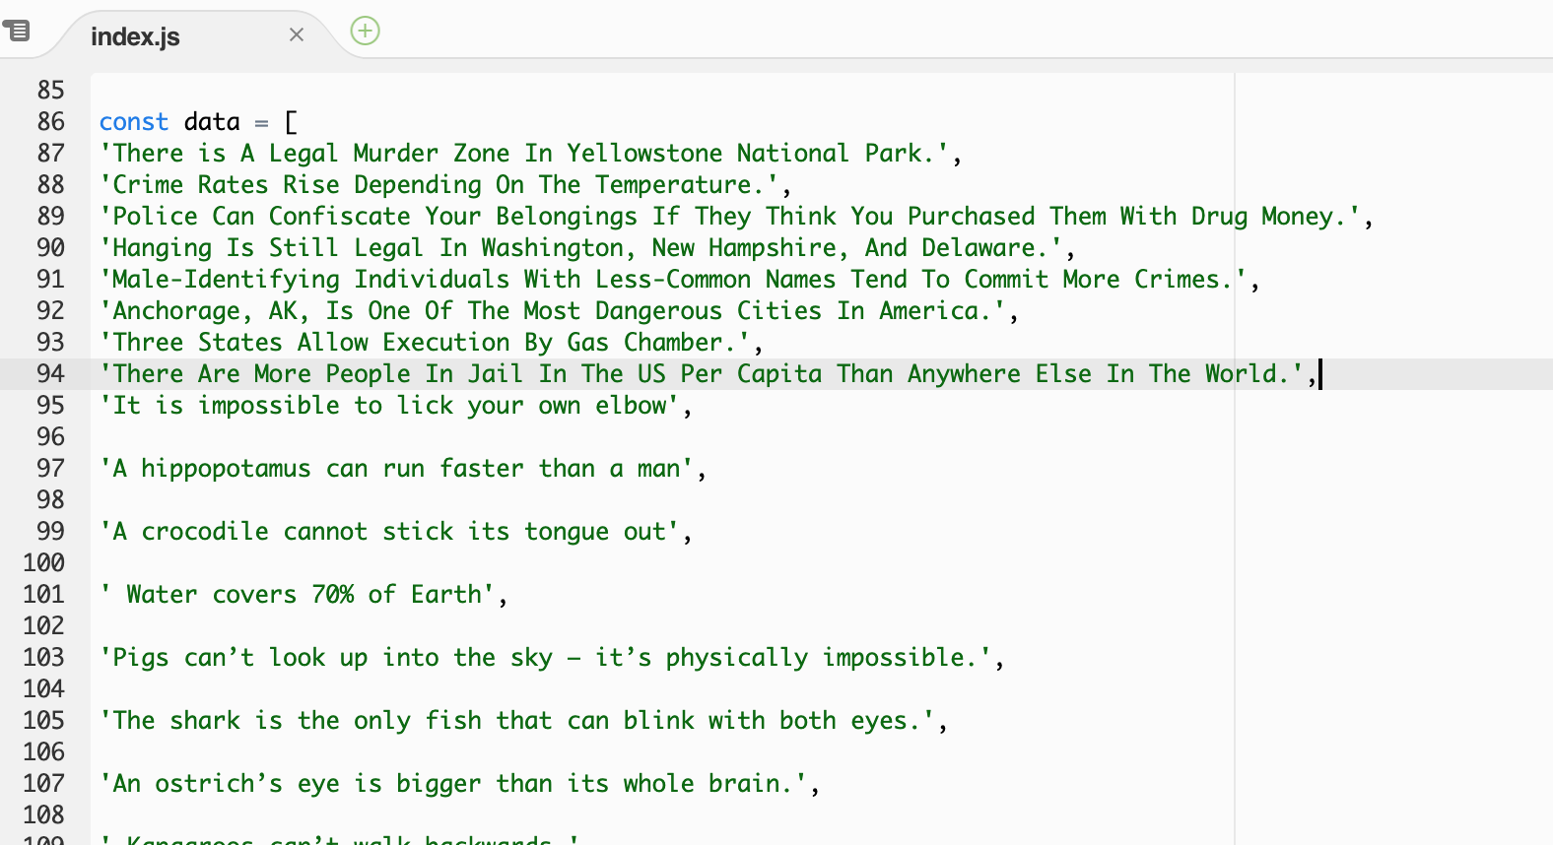
Screenshots

Slide 18
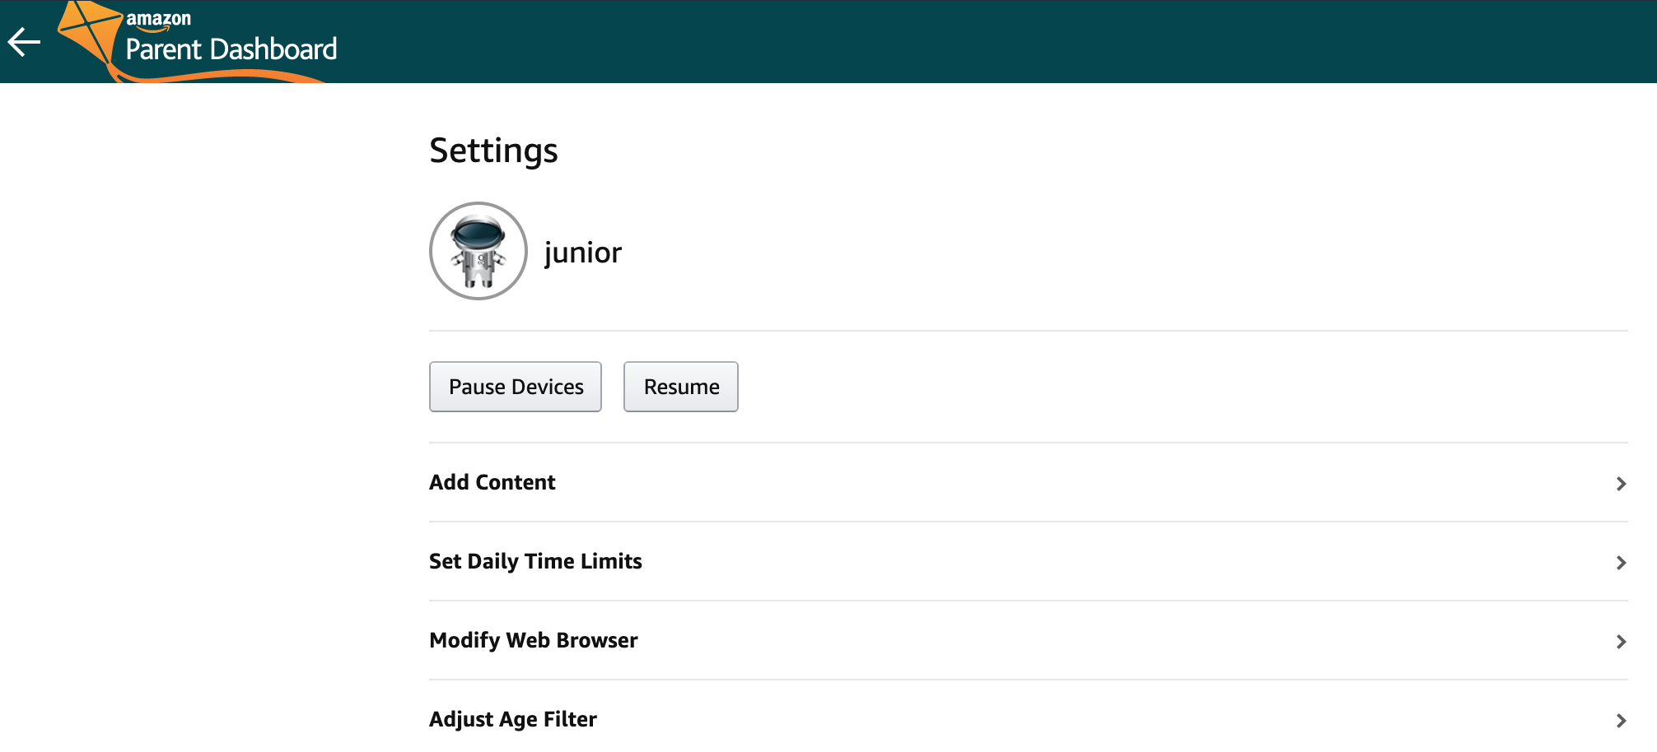
Screenshots

Slide 19
Attack scenario 2
Capturing Data
What Capturing important data from user through a story or a error message to do attacks.
Sample Attack
Alexa skill may be changed to do malicious activities after certification by changing code in Lambda.

Slide 20
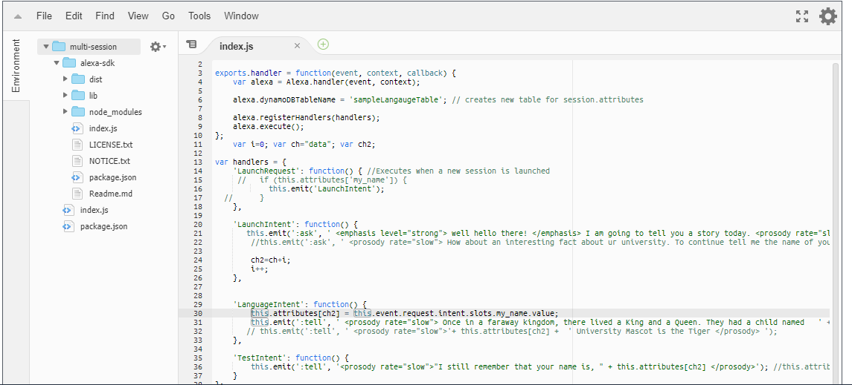
Screenshots
Lambda

Slide 21
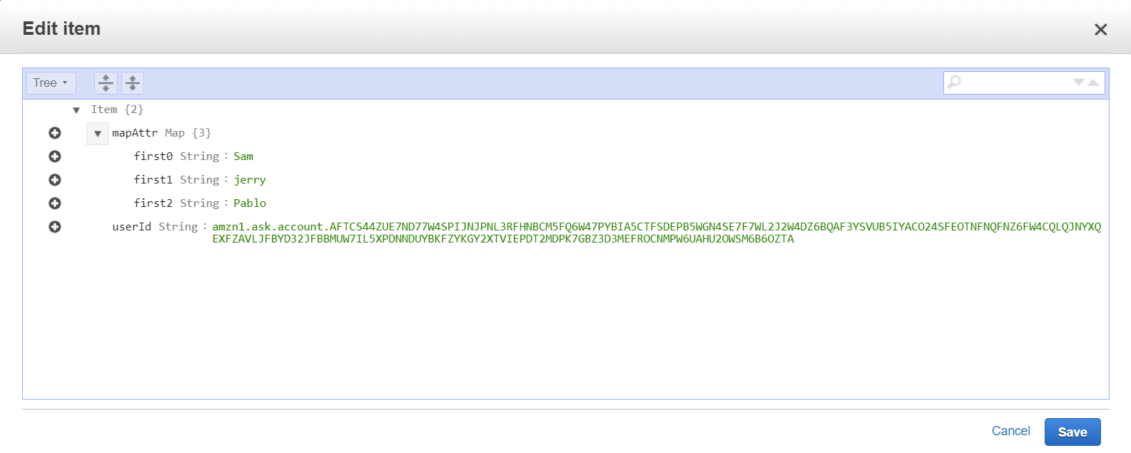
Screenshots
DynamoDB

Slide 22
Demo
Alexa will correctly say an appropriate statement like a fact
Alexa will respond in an inappropriate manner.

Slide 23
Demo
Tell a story with the user being a character. Thus capturing the name
Tell a fact about to the user/kids which is not true or not suitable to their age.

Slide 24
How to Prevent?
Remove Lambda backend hosting and allowing only Alexa hosted backend.
Implement an automated analyser that checks the change in content and sends the skill for recertification if it detects something suspicious.

Slide 25
Sources
https://www.zdnet.com/article/alexa-and-google-home-devices-leveraged-to-phish-and-eavesdrop-on-users-again/
https://threatpost.com/new-way-found-to-use-alexa-google-to-voice-phish-and-eavesdrop-on-users/149352/

Slide 26
Thank you!!
Questions??

